Slide 1

DHANEKULA INSTITUTE OF ENGINEERING AND TECHNOLOGY
Ganguru, Krishna Dist., A.P,INDIA, Pin:521139
DEPARTMENT OF INFORMATION TECHNOLOGY
Batch:16
Sign Language Translation with Python
Under Esteemed Guidance of
Mrs P. Kamakshi, M.tech, (Ph.D)
Assistant Professor, IT
Team Members:
N. Himasai (218T1A1237)
K. Navyatha (218T1A1227)
Sk. Galib Shaheed (218T1A1245)
K.V. Sai Krishna (228T5A1205)

Slide 2
CONTENTS
Introduction
Main Objective
Literature Survey
Existing System
Proposing System
Software & Hardware Requirements
Software Design
Algorithms used
UML Diagrams
Types of testing
Results
Advantages & Applications
Conclusion
Future Scope

Slide 3
INTRODUCTION
Communication is essential for expressing thoughts, emotions, and ideas.
People with hearing or speech impairments face challenges in communication.
Traditional aids (interpreters, text systems, sign language dictionaries) have limitations:
Limited accessibility
Lack of real-time responsiveness
Scalability issues
The Sign Language Conversion System addresses these challenges using:
Python, MediaPipe, Machine learning
Features of the system:
Real-time, automated, bi-directional communication
Converts sign language gestures into text and vice versa
Facilitates seamless interaction between impaired individuals and the general population
Promotes inclusivity, accessibility, and ease of communication

Slide 4
MAIN OBJECTIVE
The Sign Language Conversion System bridges communication gaps between hearing-impaired and speaking-impaired individuals and the general population. This project uses Python with MediaPipe and machine learning to interpret sign language gestures into text, which is sent to a mobile app via ThingSpeak. Similarly, text messages sent from the mobile app are converted into sign language gestures displayed on a laptop screen, enabling effective two-way communication. The solution integrates machine learning, and real-time processing to empower accessibility and inclusivity.

Slide 5
LITERATURE SURVEY
Paper 1: Continuous Sign Language Recognition with Deep Learning
Authors: Boris Mocialov, et al.
Uses hybrid CNN + RNN model for better accuracy in continuous sign language.
Focuses on real-time processing and temporal gesture analysis.
Tested on public datasets, performs better than traditional methods.
Paper 2: Deep Learning for Real-Time Sign Language Gesture Recognition
Authors: Rajesh Kumar, et al.
Uses CNNs for fast and accurate gesture recognition from video input.
Compares different CNN models on various datasets.
Highlights AI’s potential for real-world sign language translation.

Slide 6
Paper 3: Hand Gesture Recognition Using MediaPipe
Authors: Sandeep Reddy
Uses MediaPipe + deep learning for real-time sign language to text conversion.
Focus on lightweight models for mobile and embedded use.
Proposes improvements like multi-angle tracking and sequence recognition
Paper 4: Machine Translation between Spoken Languages and Signed Languages in Sign Writing
Author: Zifan Jiang
Uses Sign Writing as a bridge between spoken and signed languages.
Integrates Natural Language Processing (NLP) for automatic translation.
Converts spoken language text into structured Sign Writing symbols.
Aims to improve communication between different language users.
Addresses challenges in building efficient and smooth translation systems.

Slide 7
EXISTING SYSTEM
Human Interpreters:
Drawbacks: Expensive, dependent on availability, and not scalable.
Static Gesture Recognition Devices:
Drawbacks: Limited to predefined gestures, inflexible to new signs.
Gesture-to-Text Wearables:
Drawbacks: High cost, requires physical devices.
Sign Language Dictionaries:
Drawbacks: Not real-time or dynamic.

Slide 8
PROPOSED SYSTEM
The proposed system is a real-time, bi-directional communication tool designed for accessibility:
Message-to-Sign Conversion:
Users send a message via a mobile app developed in MIT App Inventor.
A Python script running on a laptop receives the message through ThingSpeak.
The message is converted into sign language gestures displayed as animations on the laptop.
Sign-to-Text Conversion:
A camera captures sign language gestures in real-time.
Using MediaPipe and a pre-trained machine learning model, the gestures are interpreted as text.
The text is transmitted to the mobile app for user consumption via ThingSpeak.

Slide 9
HARDWARE & SOFTWARE REQUIREMENTS
HARD REQUIRMENTS :
Laptop/PC with a camera.
Mobile device with MIT App Inventor app.
SOFTWARE REQUIREMENTS
Python (with MediaPipe and ML libraries).
MIT App Inventor for mobile app development.
ThingSpeak for cloud-based communication.
Machine Learning model for sign gesture recognition.

Slide 10
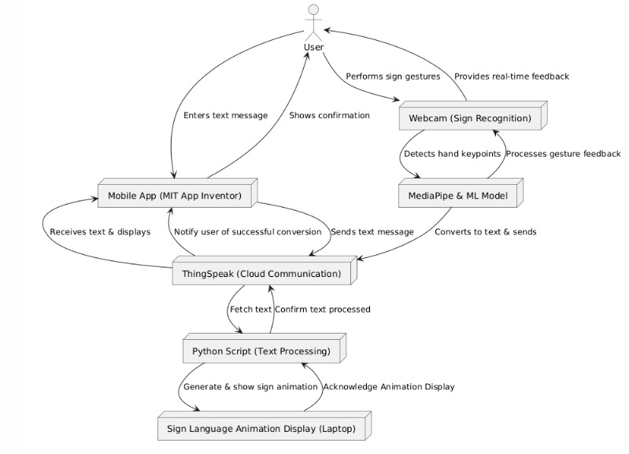
SYSTEM DESIGN
ARCHITECTURE

Slide 11
ALGORITHMS
Hand gesture detection
It utilizes computer vision and machine learning to recognize and interpret human hand movements.
Tensor flow
Media Pipe
CNNs(Convolutional Neural Networks)
CNNs are employed for feature extraction and classification of hand gestures.

Slide 12
Stage | Algorithm | Purpose
Text-to-Sign Mapping | NLP, Dictionary Mapping | Translate text into corresponding sign animations.
Gesture Detection | MediaPipe Hand Detection | Detect and track hand gestures.
Gesture Classification | Hand gesture detection, CNNs | Classify hand gestures into text or commands.
Text Conversion | Simple Mapping | Convert gesture IDs into human-readable text
Communication | ThingSpeak API | Transmit text between devices.
Optimization | PCA | Improve tracking and recognition performance.

Slide 13
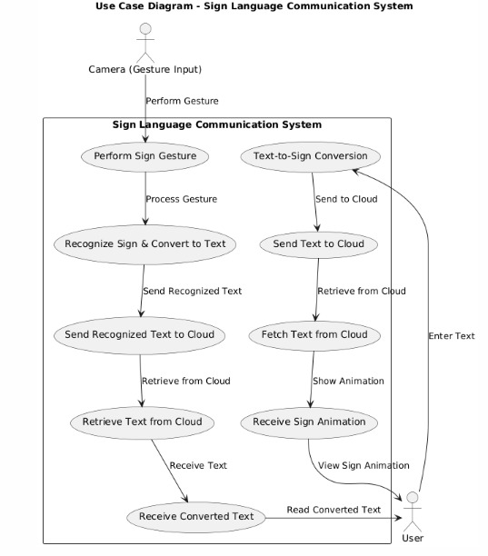
USE CASE DIAGRAM

Slide 14
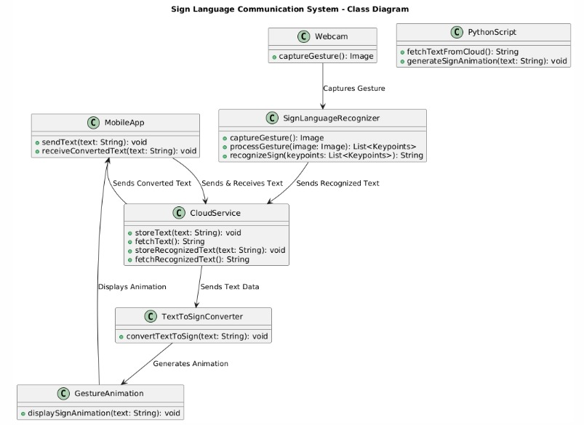
CLASS DIAGRAM

Slide 15
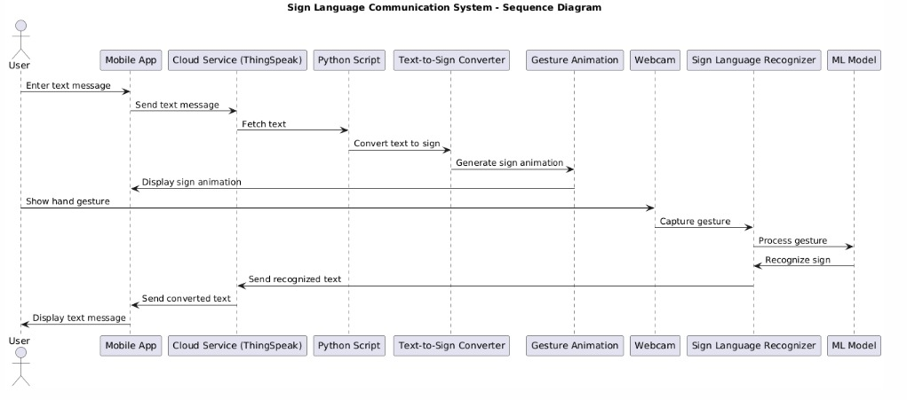
SEQUENCE DIAGRAM

Slide 16
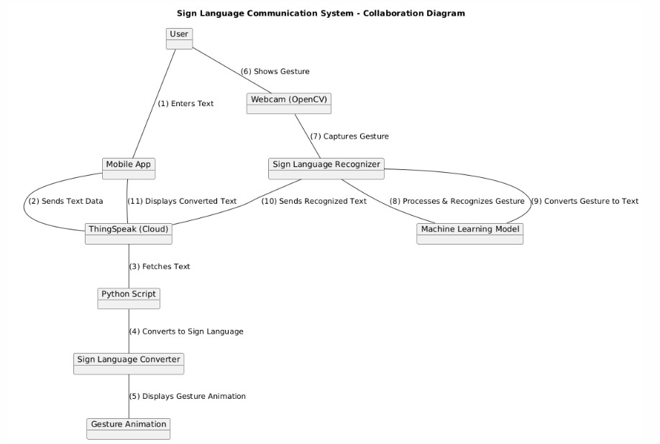
COLLABORATION DIAGRAM

Slide 17
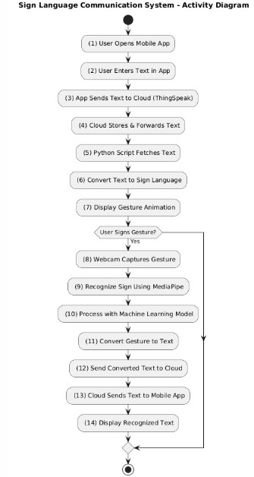
ACTIVITY DIAGRAM

Slide 18
Types of Testing
Unit Testing: Unit testing is usually conducted as part of a combined code and unit test phase of the software lifecycle, although it is not uncommon for coding and unit testing to be conducted as two distinct phases.
Test strategy and approach: Field testing will be performed manually and functional tests will be written in detail.
Test objectives
All field entries must work properly.
Pages must be activated from the identified link.
The entry screen, messages and responses must not be delayed.
Features to be tested
Verify that the entries are of the correct format
No duplicate entries should be allowed
All links should take the user to the correct page.

Slide 19
Integration Testing
Software integration testing is the incremental integration testing of two or more integrated software components on a single platform to produce failures caused by interface defects. The task of the integration test is to check that components or software applications, e.g. components in a software system or – one step up – software applications at the company level – interact without error.
Acceptance Testing
User Acceptance Testing is a critical phase of any project and requires significant participation by the end user. It also ensures that the system meets the functional requirements.
Test Results: All the test cases mentioned above passed successfully. No defects encountered.
Testing is a crucial phase in the development of the Sign Language Conversion System to ensure its reliability, accuracy, and performance. Various types of testing are implemented to validate different components of the system.

Slide 20
Test cases:
Test Case ID | Description | Input | Expected Output | Results
TC001 | Verify message transmission from mobile app | Text message | Message received by ThingSpeak | YES/NO
TC002 | Check text-to-sign conversion | "Hello" | Corresponding sign animation | ✓ YES/NO
TC003 | Validate sign recognition accuracy | Sign gesture for "Thank You" | "Thank You" displayed as text | ✓ YES/NO
TC004 | Test latency in sign interpretation | Real-time gesture | Response time < 2 sec | ✓ YES/NO
TC005 | Ensure UI usability for new users | User navigation | Easy interaction, no confusion | ✓ YES/NO

Slide 21
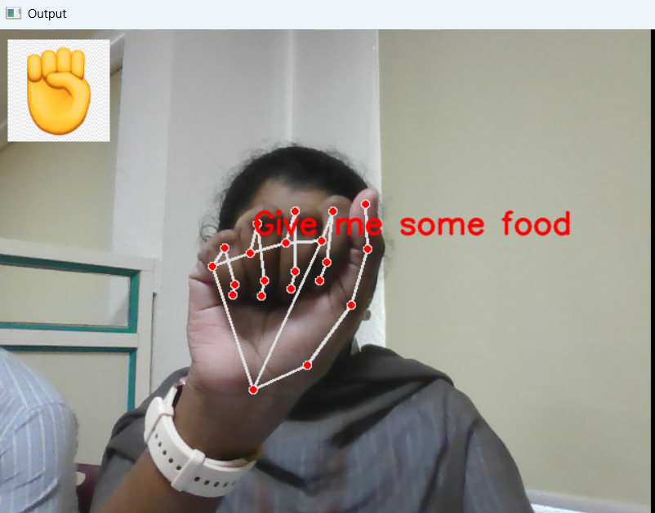
RESULTS

Slide 22
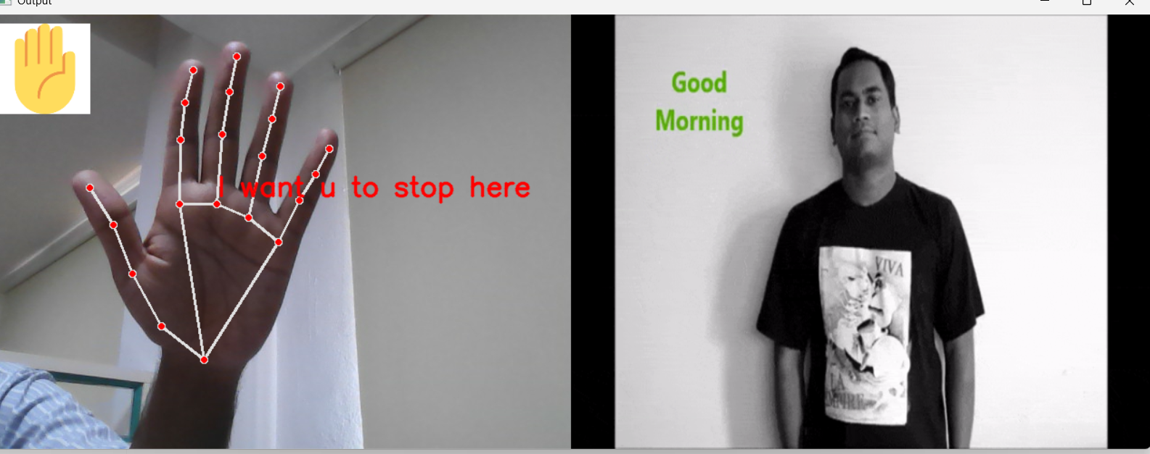

Slide 23
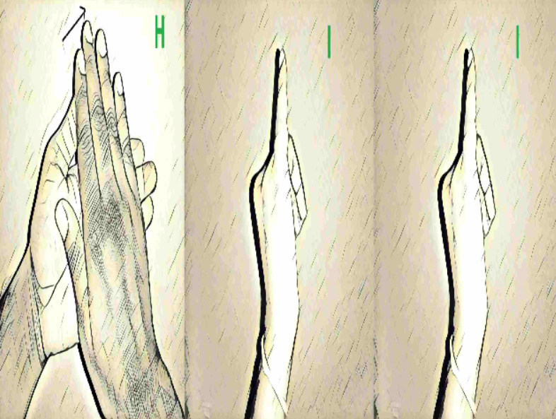

Slide 24
Advantages
Bi-Directional Communication: Supports both text-to-sign and sign-to-text conversion.
Real-Time Processing: Ensures quick response and user satisfaction.
Accessible and Scalable: Cost-effective and easily deployable for large-scale use.
Empowers Inclusivity: Enhances communication opportunities for disabled individuals.
Applications
Education: Facilitates teaching and learning for hearing and speaking-impaired students.
Healthcare: Enhances patient-doctor communication for individuals with impairments.
Customer Service: Provides accessible interaction in public service sectors.
4. Personal Communication: Improves daily interactions for disabled individuals.

Slide 25
CONCLUSION
The Sign Language Conversion System successfully addresses the communication challenges faced by hearing and speech-impaired individuals by providing a real-time, bi-directional solution that translates text into animated sign language and sign gestures into text. Using MediaPipe for gesture recognition, machine learning for interpretation, and ThingSpeak for IoT-based communication, the system ensures seamless interaction between users and non-signers.
This project is designed to be cost-effective, scalable, and easy to implement, eliminating reliance on expensive interpreters or specialized hardware. The mobile application developed using MIT App Inventor enhances accessibility, allowing users to communicate effortlessly.
By integrating AI, IoT, and real-time processing, this system can be widely applied in education, healthcare, workplaces, and public services, empowering hearing and speech-impaired individuals with greater
independence.

Slide 26
FUTURE SCOPE
Future advancements in communication technologies for individuals with impairments hold immense promise in creating a more inclusive and accessible world. By incorporating support for multiple sign languages, the system could break down language barriers, offering users the ability to communicate in their native sign language, whether it's American Sign Language (ASL), British Sign Language (BSL), or others.
This would enhance global communication, ensuring that individuals can interact seamlessly across different cultures.
The development of improved gesture recognition accuracy would enable the system to understand a wider range of complex, fast, or nuanced gestures, even in diverse environments. With more precise recognition, the technology could better cater to the varied needs of users, improving the overall communication experience.

Slide 27
